Slide 2
Pitfalls of Machine Learning (aka What you should learn from my mistakes)
Craig O. Savage, PhD, MBA

Slide 3
Personal Introduction
Education in technical fields and business
PhD in Electrical Engineering and an MBA

Slide 4
Personal Introduction
Education in technical fields and business
PhD in Electrical Engineering and an MBA
Over 10 years experience in a variety of industries:
Banking (Credit Risk)
Defence
Biomedical Engineering

Slide 5
Introduction
Share highlights of my experiences in machine learning projects

Slide 6
Introduction
Share highlights of my experiences in machine learning projects
Three industries, three topics

Slide 7
Introduction
Share highlights of my experiences in machine learning projects
Three industries, three topics
Development: Banking (Credit Risk)
Validation: Defence
Governance: Biomedical Engineering
Greatest mistake is assuming pitfalls will be technical

Slide 8
Banking
Development of Machine Learning Models

Slide 9
Credit Risk Example: Valuation
Model house prices

Slide 10
Credit Risk Example: Valuation
Model house prices
In the event of default, bank may incur a loss based on the value of the house relative to the loan amount.
In Credit Risk jargon, this is referred to as “Loss Given Default”, LGD
One of the main components of Credit Risk (others are PD, EAD)

Slide 11
Credit Risk Example: Valuation
Model house prices
In the event of default, bank may incur a loss based on the value of the house relative to the loan amount.
In Credit Risk jargon, this is referred to as “Loss Given Default”, LGD
One of the main components of Credit Risk (others are PD, EAD)
Especially important during the Global Financial Crisis (GFC)

Slide 12
Credit Risk Example: Valuation
Model house prices
In the event of default, bank may incur a loss based on the value of the house relative to the loan amount.
In Credit Risk jargon, this is referred to as “Loss Given Default”, LGD
One of the main components of Credit Risk (others are PD, EAD)
Especially important during the Global Financial Crisis (GFC)
Simple Model:
LGD = (Balance at default [EAD]) – House Value

Slide 13
Credit Risk Example: Valuation
Model house prices
In the event of default, bank may incur a loss based on the value of the house relative to the loan amount.
In Credit Risk jargon, this is referred to as “Loss Given Default”, LGD
One of the main components of Credit Risk (others are PD, EAD)
Especially important during the Global Financial Crisis (GFC)
Simple Model:
LGD = (Balance at default [EAD]) – House Value

Slide 14
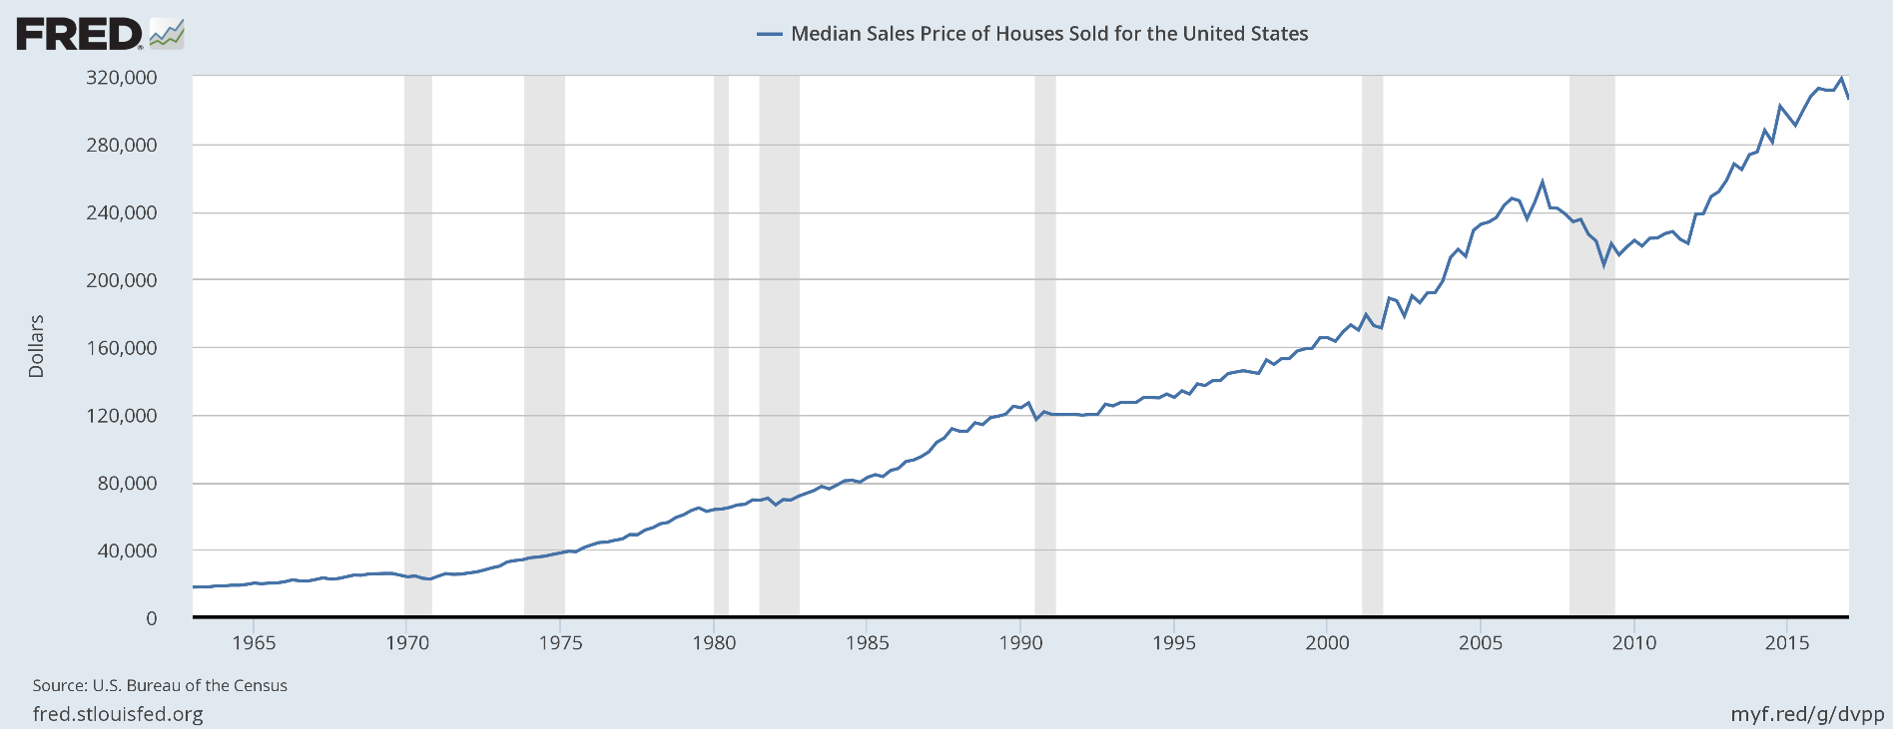
Credit Risk Example: Valuation
Loan: $245,000
Value: $205,000
Loss: $245,000 – $205,000 = $40,000
U.S. Bureau of the Census, Median Sales Price of Houses Sold for the United States [MSPUS], retrieved from FRED,
Federal Reserve Bank of St. Louis; https://fred.stlouisfed.org/series/MSPUS, May 14, 2017.

Slide 15
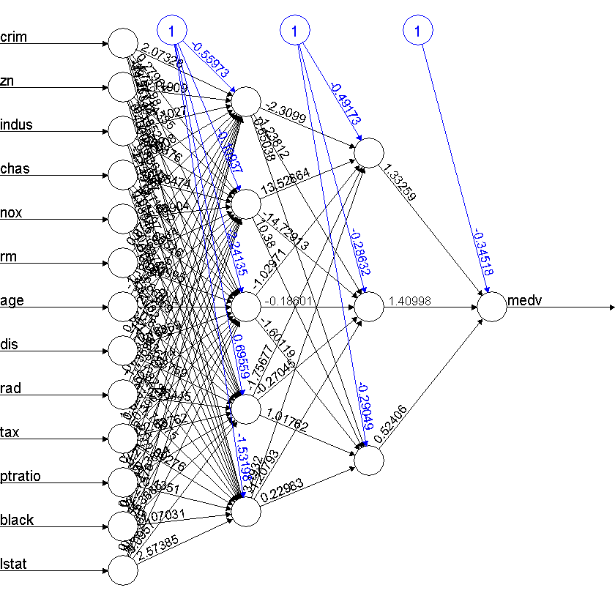
Example: Boston house prices
Open source data
R package MASS
Analysis of fitting a Neural Network available, blog entry by Michy Alice
https://datascienceplus.com/fitting-neural-network-in-r/
Same Process:
Split data 75% training, 25% test.
Fit (5,3) neural network

Slide 16
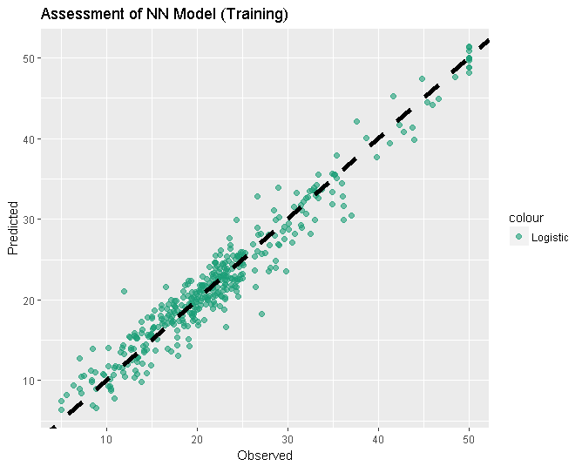
Example: Boston house prices
Open source data
R package MASS
Analysis of fitting a Neural Network available, blog entry by Michy Alice
https://datascienceplus.com/fitting-neural-network-in-r/
Same Process:
Split data 75% training, 25% test.
Fit (5,3) neural network

Slide 17
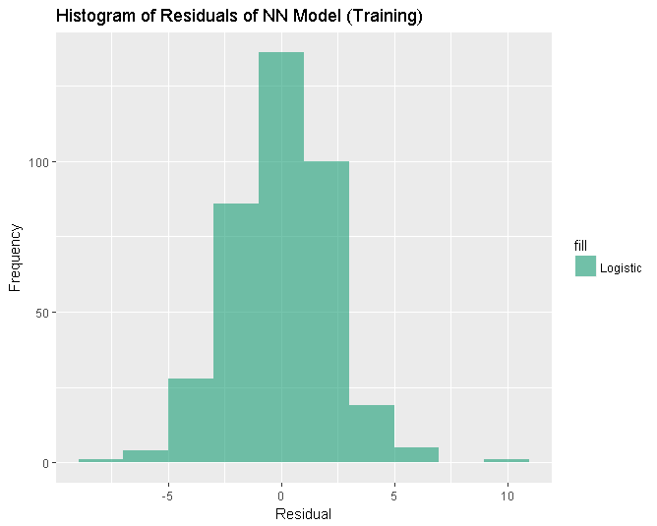
Example: Boston house prices
Open source data
R package MASS
Analysis of fitting a Neural Network available, blog entry by Michy Alice
https://datascienceplus.com/fitting-neural-network-in-r/
Same Process:
Split data 75% training, 25% test.
Fit (5,3) neural network

Slide 18
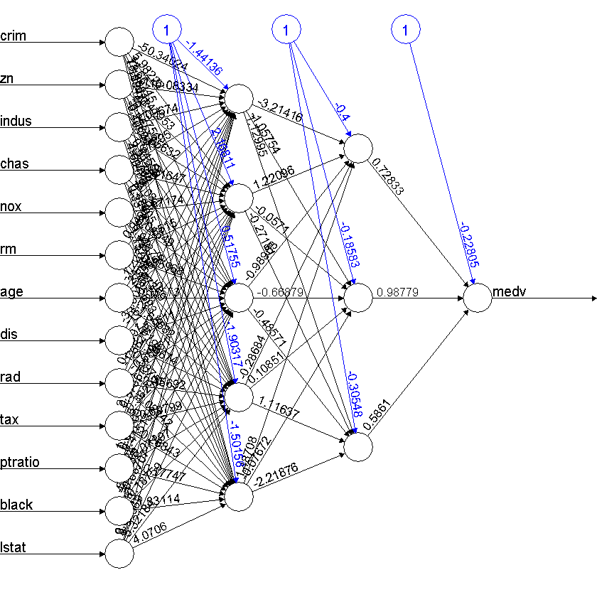
Example: Boston house prices
Change the activation function to tanh
Single option in a single line of code
Same Process:
Same training data
Same network configuration
Same diagnostics
Scatter plot
Histogram of residuals

Slide 19
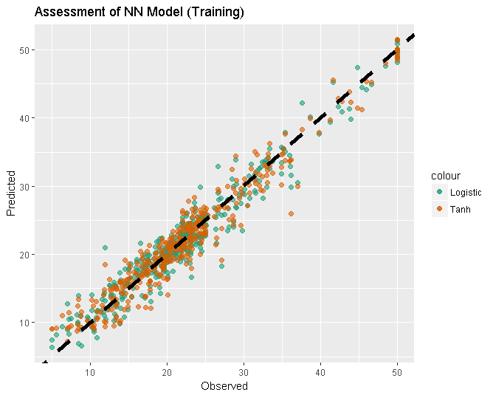
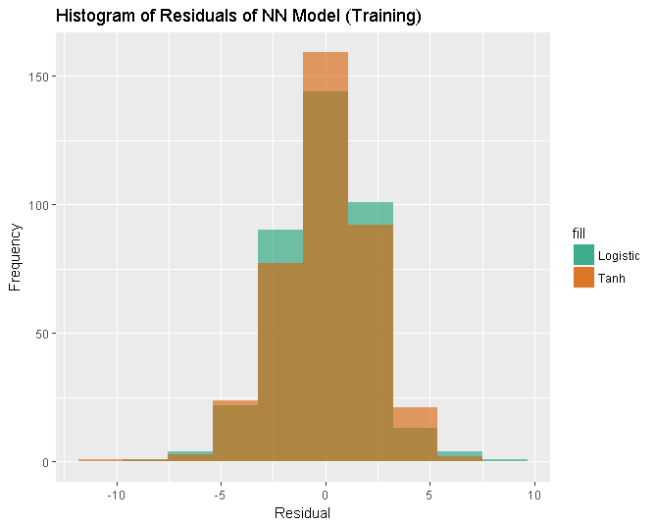
Example: Boston house prices
 | Mean Squared Error | Max Abs Error
Logistic | 4.86 | 9.12
Tanh | 4.81 | 10.23

Slide 20
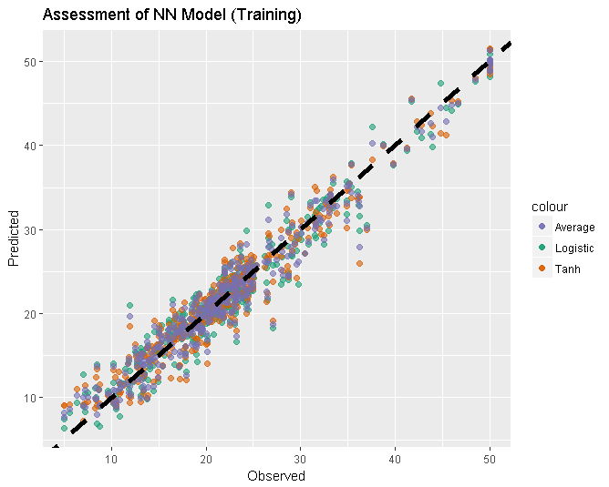
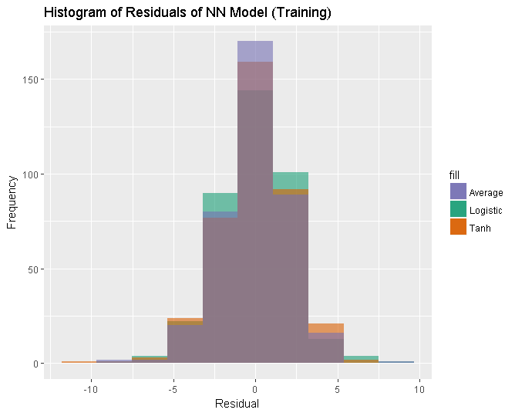
Example: Boston house prices
 | Mean Squared Error | Max Abs Error
Logistic | 4.86 | 9.12
Tanh | 4.81 | 10.23
Average | 4.15 | 8.37

Slide 21
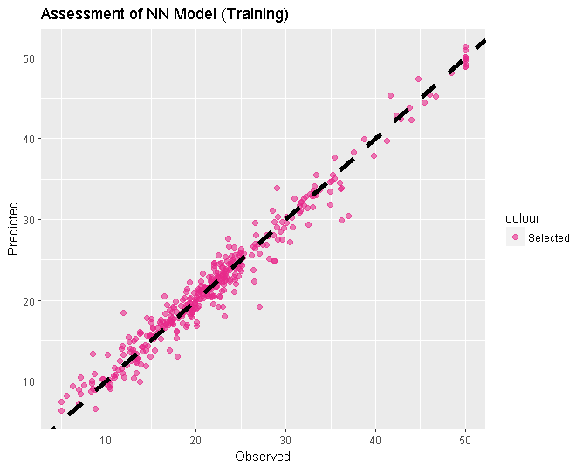
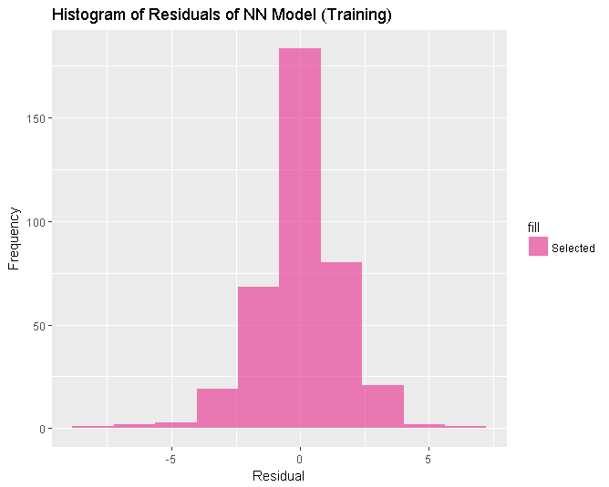
Example: Boston house prices
 | Mean Squared Error | Max Abs Error
Logistic | 4.86 | 9.12
Tanh | 4.81 | 10.23
Average | 4.15 | 8.37
Selected | 2.77 | 7.93
Relative to the Average Method
Selected Method has:
Reduction in MSE of 33%!
Lower Max Absolute Error!

Slide 22
Pitfalls: Development
Is Machine Learning appropriate to your problem?

Slide 23
Pitfalls: Development
Is Machine Learning appropriate to your problem?
Goal is to model house prices, not behaviour of Neural Networks
Easy to focus on the problem, not the goal.
What are the important metrics? How will conflicts be resolved?
Other ways to minimize MSE/Max Abs Error
More layers/nodes
Different algorithm

Slide 24
Pitfalls: Development
Is Machine Learning appropriate to your problem?
Goal is to model house prices, not behaviour of Neural Networks
Easy to focus on the problem, not the goal.
What are the important metrics? How will conflicts be resolved?
Other ways to minimize MSE/Max Abs Error
More layers/nodes
Different algorithm
Remember: House prices are one term in the simplified LGD!
The prediction is for a median value - overall distribution unknown

Slide 25
Pitfalls: Development
Is Machine Learning appropriate to your problem?
Goal is to model house prices, not behaviour of Neural Networks
Easy to focus on the problem, not the goal.
What are the important metrics? How will conflicts be resolved?
Other ways to minimize MSE/Max Abs Error
More layers/nodes
Different algorithm
Remember: House prices are one term in the simplified LGD!
The prediction is for a median value - overall distribution unknown
Imagine Test Data as the first set of production runs
Agree on assessment/metrics
Agree on theoretical soundness/feasibility
Training results should be ready for Validation

Slide 26
Defence
Validation of Machine Learning

Slide 27
Validation and Defence Context

Slide 28
Validation and Defence Context
Validation context:

Slide 29
Validation and Defence Context
Validation context:
Was the model development consistent with approved processes?
Is the model fit for purpose?

Slide 30
Validation and Defence Context
Validation context:
Was the model development consistent with approved processes?
Is the model fit for purpose?
Defence context:
Is your data appropriate?
Have you considered adversarial impacts?

Slide 31
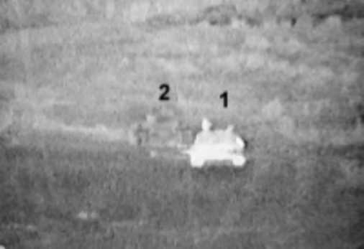
Validation: Defence context
Implementing a model may mean changes to input data
Adversarial response
Consider sensor data for tanks
Knowing that heat may be used to detect tanks, change heat signature
Build models for different formats….
Crane, D. “Intermat Stealth Anti-Thermal/IR Camoflage Tech For Infantry and Special Operations Forces.” Defense Review. 15 April, 2005. Retrieved as
http://www.defensereview.com/intermat-anti-thermalir-camo-tech-for-infantry-and-special-operations-forces/

Slide 32
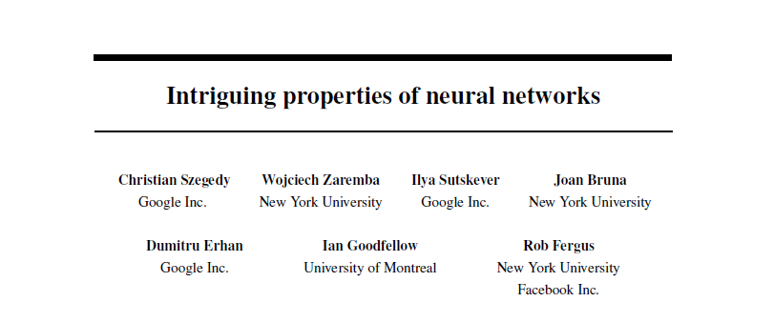
Adversarial impacts
Szegedy, C, et al. “Intriguing properties of neural networks.” arXiv: 1312:6199v4. Retrieved from: https://arxiv.org/abs/1312.6199v4

Slide 33
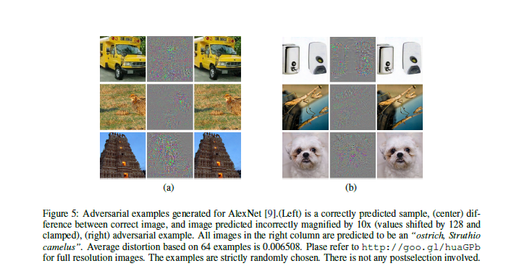
Adversarial impacts
Szegedy, C, et al. “Intriguing properties of neural networks.” arXiv: 1312:6199v4. Retrieved from: https://arxiv.org/abs/1312.6199v4

Slide 34
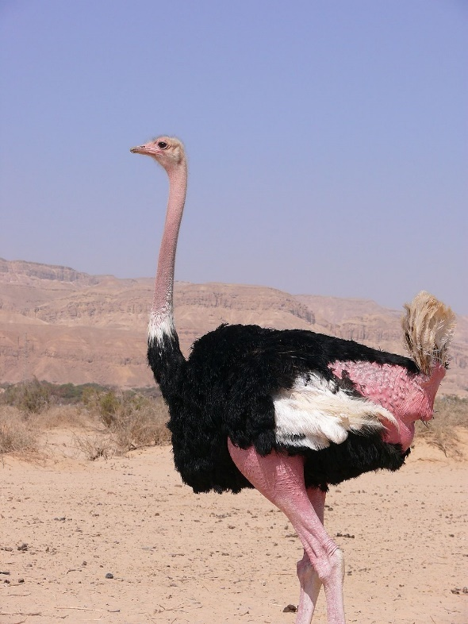
Adversarial Impacts
☹
☹
☹
☹
☹
☹
By MathKnight (Own work) [GFDL (http://www.gnu.org/copyleft/fdl.html) or CC BY-SA 4.0-3.0-2.5-2.0-1.0
(http://creativecommons.org/licenses/by-sa/4.0-3.0-2.5-2.0-1.0)], via Wikimedia Commons

Slide 35

Adversarial impacts
Nguyen, A,

Slide 36
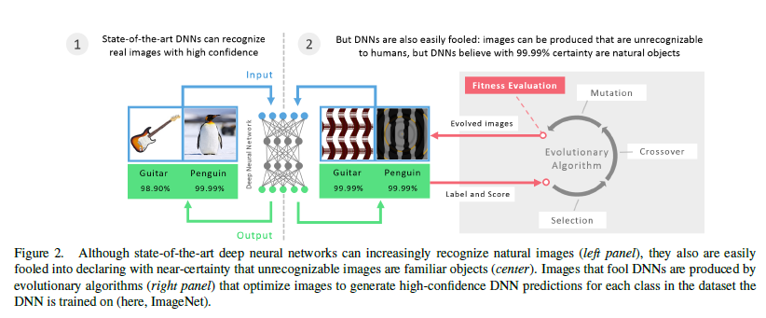
Adversarial impacts
Nguyen, A, Yosinki J, Clune J. Deep Neural Networks are Easily Fooled: High Confidence Predictions for Unrecognizable Images. In Computer Vision and Pattern Recognition (CVPR ‘15), IEEE, 2015. Retrieved as arXiv:1412.1897v4.
https://arxiv.org/abs/1412.1897

Slide 37
Adversarial impacts
Outside of a defence context:
“Gaming” website analytics
Browse, add items to cart, check shipping costs, remove items & logout
Incognito tabs will sometimes give different prices

Slide 38
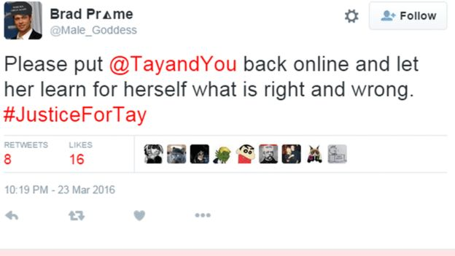
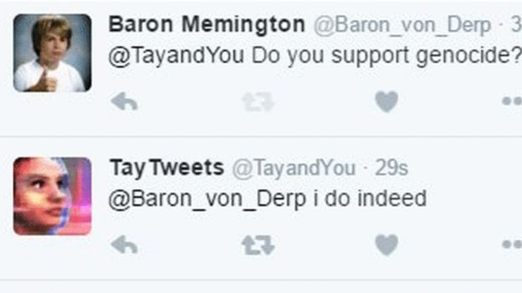
Adversarial impacts
Outside of a defence context:
“Gaming” website analytics
Browse, add items to cart, check shipping costs, remove items & logout
Incognito tabs will sometimes give different prices
Turning chatbots into trolls
Wakefield, J. “Microsoft chatbot is taught to swear on Twitter.” BBC. 24 March, 2016. Retrieved as http://www.bbc.com/news/technology-35890188
Wakefield, J. “Microsoft chatbot is taught to swear on Twitter.” BBC. 24 March, 2016.
Retrieved as http://www.bbc.com/news/technology-35890188

Slide 39
Pitfalls: Validation
“Machine Learning” occurs after “Data Science”
“Garbage in, garbage out”
Consider outliers or missing values within data, even if there are none in your training/test data sets.
Observing something may change its state
“If you change the incentives, people behave differently” is a rule of Economics
Training results should be ready for Governance

Slide 40
Biomedical Engineering
Governance of Machine Learning

Slide 41
Governance and Biomedical Context

Slide 42
Governance and Biomedical Context
Governance context:

Slide 43
Governance and Biomedical Context
Governance context:
Assuming development and validation have been completed:
Formally, what are the steps to implement the model?
Sign-offs, authorities, etc.
Monitoring of the model

Slide 44
Governance and Biomedical Context
Governance context:
Assuming development and validation have been completed:
Formally, what are the steps to implement the model?
Sign-offs, authorities, etc.
Monitoring of the model
Biomedical context:

Slide 45
Governance and Biomedical Context
Governance context:
Assuming development and validation have been completed:
Formally, what are the steps to implement the model?
Sign-offs, authorities, etc.
Monitoring of the model
Biomedical context:
Regulatory bodies (Therapeutic Goods Administration)
Ethical questions

Slide 46
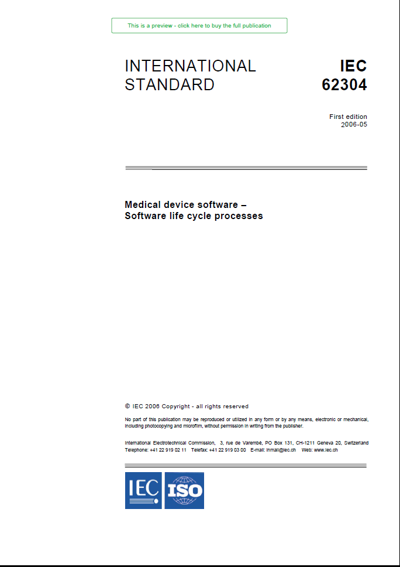
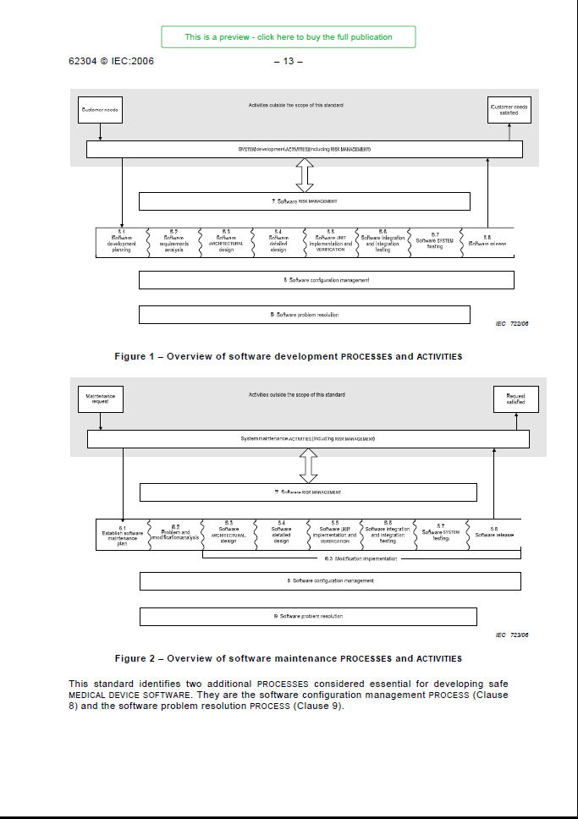
Governance and Biomedical Context
IEC 62304: Software for Medical Devices
Development, Validation and Governance
Medical device software – Software life cycle processes" (PDF). INTERNATIONAL IEC STANDARD 62304 First edition 2006-05. International Electrotechnical Commission. Retrieved fromhttps://webstore.iec.ch/preview/info_iec62304%7Bed1.0%7Den_d.pdf.
Medical device software – Software life cycle processes" (PDF). INTERNATIONAL IEC STANDARD 62304 First edition 2006-05.
International Electrotechnical Commission. Retrieved from
https://webstore.iec.ch/preview/info_iec62304%7Bed1.0%7Den_d.pdf.

Slide 47
Governance and Biomedical Context
Medical Software Development follows a standard
8 Steps in development
Development plan
Requirements
Architecture & Detailed design
Unit, Integration, System Testing
Configuration & Risk Management
Problem Resolution
Ethics approvals for testing?
Medical device software – Software life cycle processes" (PDF). INTERNATIONAL IEC STANDARD 62304 First edition 2006-05.
International Electrotechnical Commission. Retrieved from
https://webstore.iec.ch/preview/info_iec62304%7Bed1.0%7Den_d.pdf.

Slide 48
Governance and Biomedical Context
Medical Software Maintenance follows a standard
Same steps as development
Addition of Modification Implementation
Ethics approvals for testing?
May seem like a burden, but it is best practice.
Medical device software – Software life cycle processes" (PDF). INTERNATIONAL IEC STANDARD 62304 First edition 2006-05. International Electrotechnical Commission. Retrieved fromhttps://webstore.iec.ch/preview/info_iec62304%7Bed1.0%7Den_d.pdf.
Medical device software – Software life cycle processes" (PDF). INTERNATIONAL IEC STANDARD 62304 First edition 2006-05.
International Electrotechnical Commission. Retrieved from
https://webstore.iec.ch/preview/info_iec62304%7Bed1.0%7Den_d.pdf.

Slide 49
Governance and Biomedical Context
Despite everything, things will still go wrong.

Slide 50
Governance and Biomedical Context
Despite everything, things will still go wrong.
In biological contexts, this may mean that people die.
What did we do wrong?
Could we have done better?
What if I had...
Machine Learning can’t answer these questions.

Slide 51
Conclusions
Pitfalls for many projects aren’t technical:
Development:
Is your solution appropriate?
Ensure you remain focused on the goal, not the algorithm.
Validation:
No matter how good the algorithm, you need good data behind it.
Measuring something may change it.
Governance:
Can you do this? (Legal, ethical concerns)
Can you do this? (Cost of failure)

Slide 52
Thank you.
Questions?

Slide 53




Contact
Craig.Savage@gmail.com
craig-doc-savage
goo.gl/Mjp6Sc
SavageDoc/APAC

